Slide 1
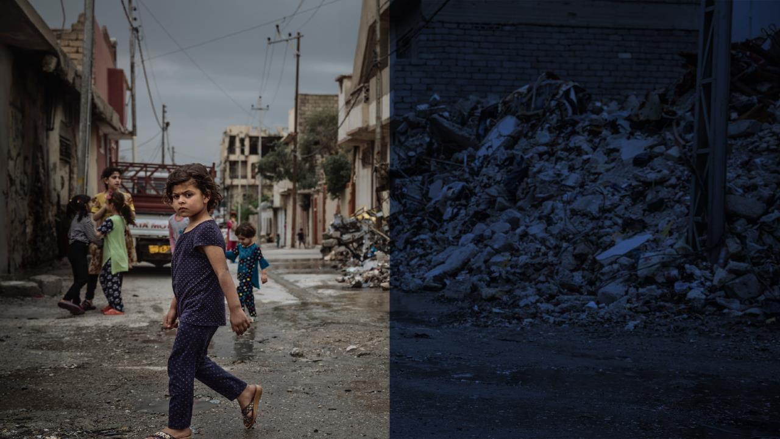
INTRODUCTION TO COUNTER-TRAFFICKING IN EMERGENCIES INFORMATION MANAGEMENT
SESSION 1
TRAFFICKING IN PERSONS in EMERGENCIES and ROLE of INFORMATION MANAGEMENT
International Organization for Migration
Benedetta Cordaro

Slide 2
THIS WEBINAR WILL BE RECORDED
INTRODUCTION TO COUNTER-TRAFFICKING IN EMERGENCIES INFORMATION MANAGEMENT
SESSION 1
TRAFFICKING IN PERSONS in EMERGENCIES and ROLE of INFORMATION MANAGEMENT
PLEASE MUTE YOUR MICROPHONE
PLEASE TURN OFF YOUR CAMERA
FOR ANY QUESTION, PLEASE USE THE CHAT BOX

Slide 3

Author
Benedetta Cordaro
Counter-Trafficking in Emergencies
Migrant Protection and Assistance (MPA)

Slide 4
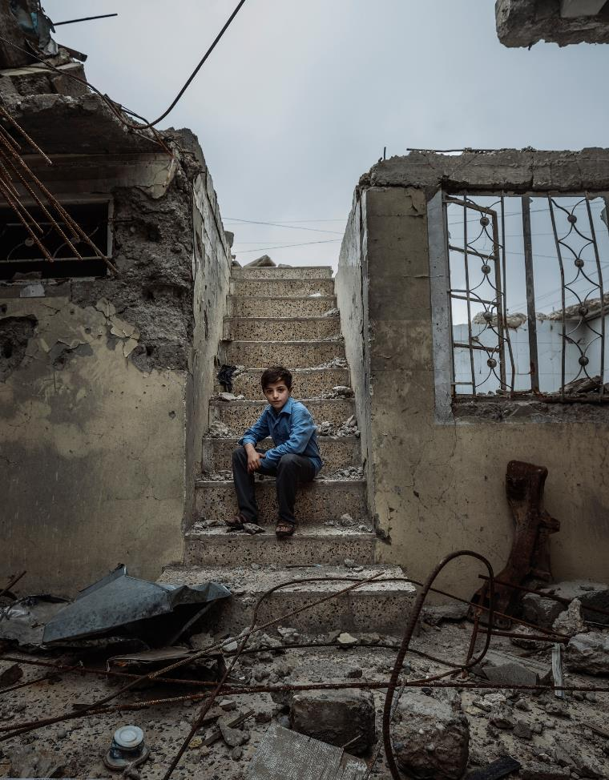
Agenda
Introduction: training curriculum
Definition of trafficking in persons
Existing data and research on trafficking in persons
Trafficking in persons in emergencies
Function and purpose of CT information management in emergencies
Questions

Slide 5
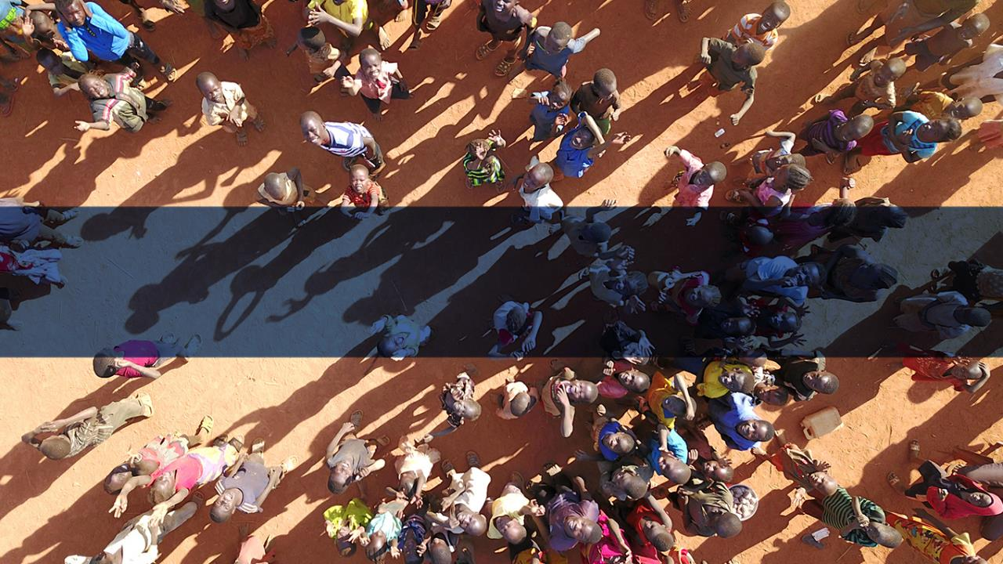
1. Introduction : training curriculum

Slide 6
1. Introduction : training curriculum
PURPOSE
Integration of Counter-trafficking (CT) specific information management (IM) activities;
Support evidence-based decision-making regarding CT in emergency contexts;
Foster cooperation between protection and information management staff.
AUDIENCE
Staff with protection background
Staff with information management / research background / analysis background
Staff with experience in emergencies or likely to be deployed to emergencies

Slide 7
1. Introduction : training curriculum
Module
Module 1 – Trafficking in persons in emergencies and role of CTiE IM
Module 2 – Ethical concerns and safeguards: protection information management
Module 3 - CT information management in emergencies: CTiE analysis framework
Module 4 - CTiE information management in emergencies: CTiE indicators
Module 5 - CT information management in emergencies: research methods

Slide 8
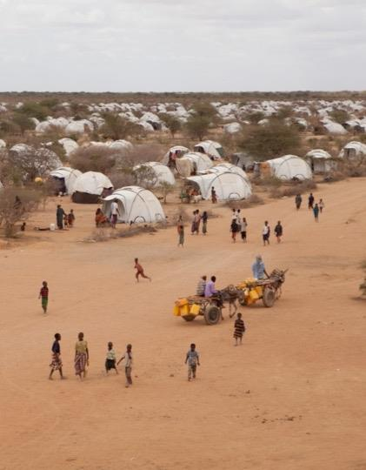
1. Introduction : training curriculum
Counter-Trafficking in Emergencies: Information Management Guide (2020)
Based on pre-draft rounds of consultations with over 30 experts
Reviewed by 30 IOM and 60 external experts:
  Child Protection AoR (CP AoR)
  Danish Refugee Council (DRC)
  Gender-Based Violence AoR (GBV AoR)
  Global Protection Cluster (GPC)
  Global Protection Cluster Anti-Trafficking Task Team (GPC ATTT)
  International Federation of Red Cross (IFRC)
  International Labour Organization (ILO)
  Office of the United Nations High Commissioner for Human Rights (OHCHR)
  REACH
  United Nations Children’s Fund (UNICEF)
  United Nations Entity for Gender Equality and the Empowerment of Women (UN-Women)
  United Nations High Commissioner for Refugees (UNHCR)
  United Nations Office on Drugs and Crime (UNODC)
  United Nations Population Fund (UNFPA)

Slide 9

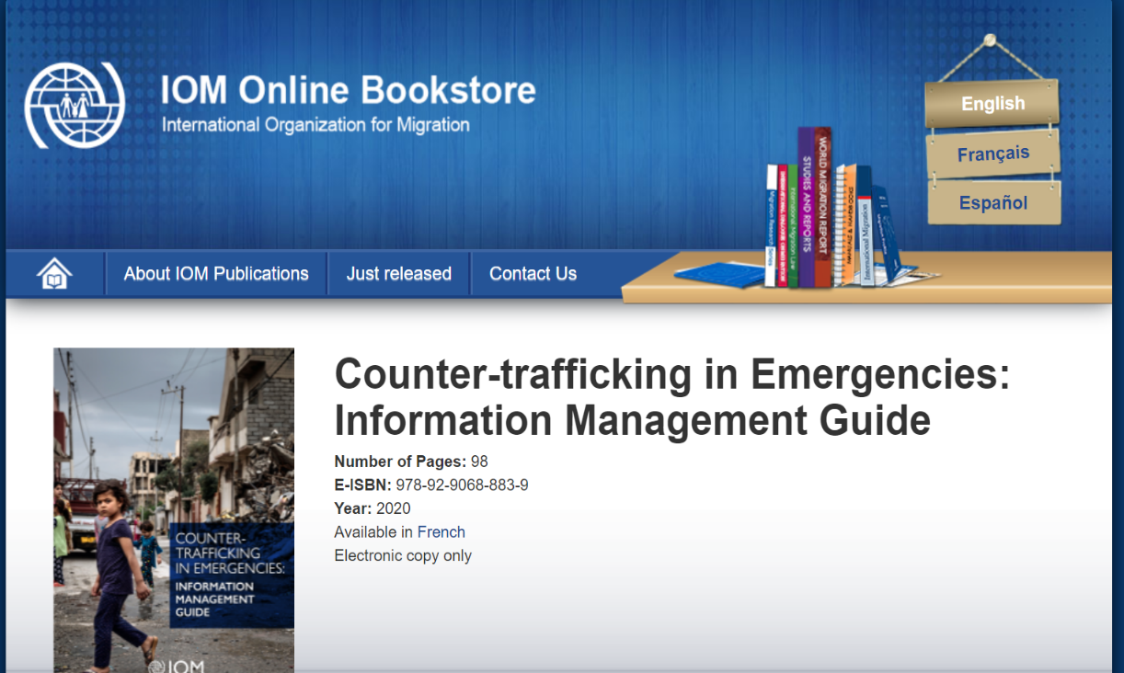
1. Introduction : training curriculum

Slide 10
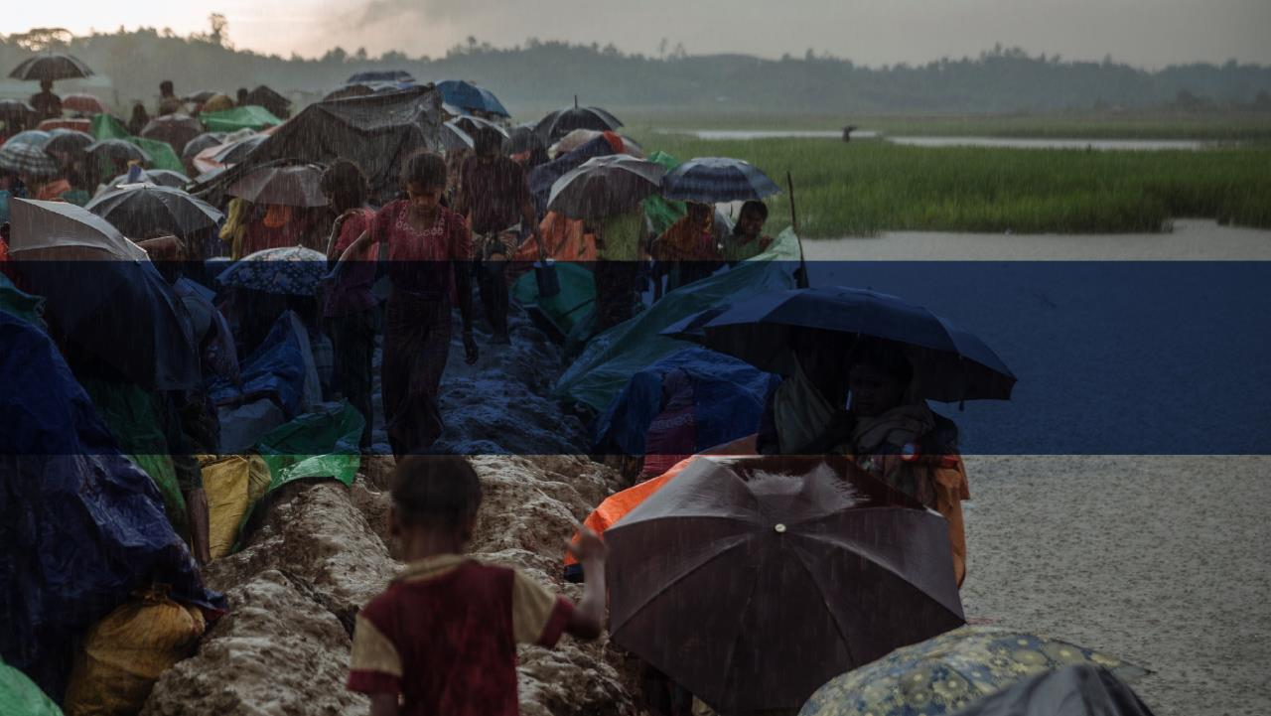
2. Definition of trafficking in persons

Slide 11
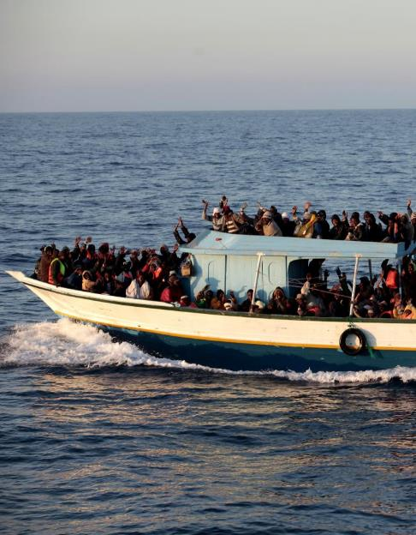
2. Definition of trafficking in persons
«Trafficking in persons is defined as "the recruitment, transportation, transfer, harbouring or receipt of persons, by means of the threat or use of force or other forms of coercion, of abduction, of fraud, of deception, of the abuse of power or of a position of vulnerability or of the giving or receiving of payments or benefits to achieve the consent of a person having control over another person, for the purpose of exploitation. »
UN Protocol to Prevent, Suppress and Punish Trafficking in Persons Especially Women and Children, otherwise known as Palermo Protocol (2000)

Slide 12
2. Definition of trafficking in persons
ACT
(what is done)
MEANS
(how it is done)
PURPOSE
(why it is done)
Harbouring
Reception of a person
Recruitment
Transfer
Transport
Other
Abduction
Abuse of power
Abuse of vulnerability
Coercion
Deception
Fraud
Threat or use of force
Withholding of payments or benefits
Other
Exploitation, including:
Child labour exploitation
Coercive illegal activities
Coercive reproduction
Domestic servitude
Forced labour
Labour exploitation
Forced marriage
Forced military recruitment
Illegal adoption
Organ removal
Prostitution or sexual exploitation
Slavery
Other
+
+
=
Trafficking in Persons (Adults)

Slide 13
2. Definition of trafficking in persons
ACT
(what is done)
MEANS
(how it is done)
PURPOSE
(why it is done)
Harbouring
Reception of a person
Recruitment
Transfer
Transport
Other
Abduction
Abuse of power
Abuse of vulnerability
Coercion
Deception
Fraud
Threat or use of force
Withholding of payments or benefits
Other
Exploitation, including:
Child labour exploitation
Coercive illegal activities
Coercive reproduction
Domestic servitude
Forced labour
Labour exploitation
Forced marriage
Forced military recruitment
Illegal adoption
Organ removal
Prostitution or sexual exploitation
Slavery
Other
+
+
=
Trafficking in Persons (Children*)

Slide 14
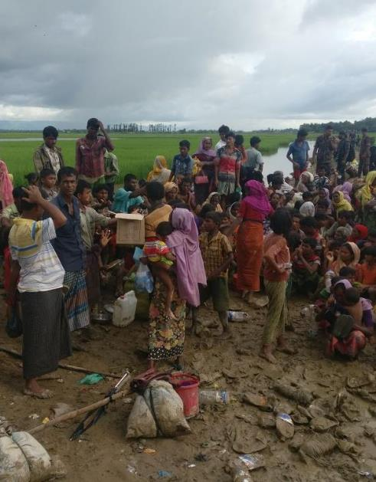
2. Definition of trafficking in persons
Exercise:
Identify for each example the act, the means and the purpose
* PLEASE WRITE YOUR ANSWER IN THE CHAT BOX

Slide 15
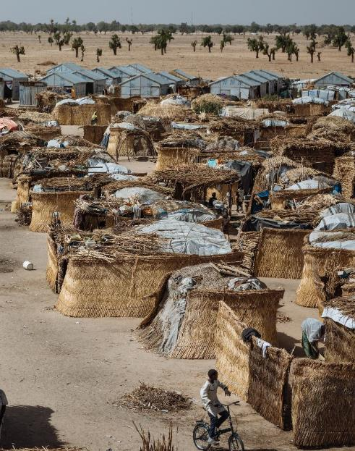
2. Definition of trafficking in persons
Example 1:
A migrant pays a smuggler to provide transportation across the desert and cross the border. During the journey the smuggler threatens the migrant to leave him in the middle of the desert if he does not carry drugs for him.

Slide 16
2. Definition of trafficking in persons
ACT
Transfer
Transport
MEANS
Abuse of power vulnerability
Coercion
Deception
Threat or use of force
PURPOSE
Forced illicit activity

Slide 17
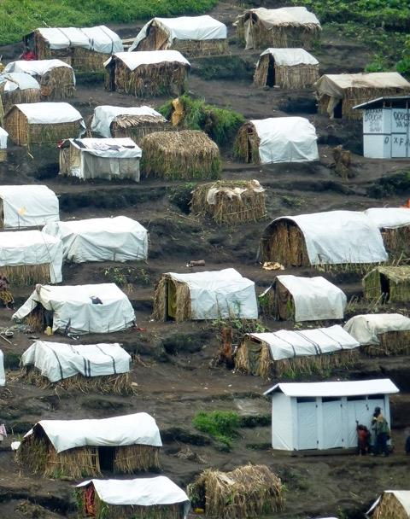
2. Definition of trafficking in persons
Example 2:
A young IDP woman is offered to work as a maid in an hotel in a nearby costal town, where the owner would provide also accommodation. Once she arrives to the town, she finds out the hotel is actually a brothel and she is forced into prostitution. The owner of the hotel keeps almost all her earning claiming that’s the share for accommodation and food. Without money she cannot go back to her family. She is also afraid of returning without the money she was promised to support her family and she is terrified to tell what really happened, as her family and community would reject her.

Slide 18
2. Definition of trafficking in persons
ACT
Harbouring
Reception of a person
Recruitment
MEANS
Deception about job opportunity
Abuse of vulnerability
Coercion
Withholding of payments
Threat to inform her family and community
PURPOSE
Sexual exploitation

Slide 19

2. Definition of trafficking in persons
Example 3:
Militia groups kidnap kids from the koranic school of a village. Kids are transported to another location. Teenagers are forced into combat roles while younger boys are forced into support roles (cooking, taking care of the camp, collecting firewood).

Slide 20
2. Definition of trafficking in persons
ACT
Transfer
Harbouring
Reception
MEANS
NO NEED for MEANS
(Victim of trafficking is under 18).
PURPOSE
Forced activities within armed group

Slide 21
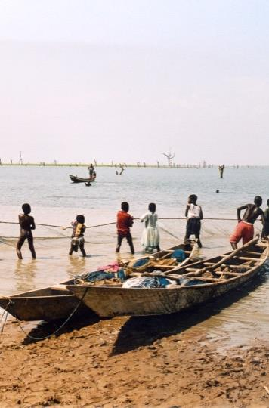
2. Definition of trafficking in persons
Example 4:
A refugee man living in a camp starts looking for job in the nearby city next to a costal town, and eventually begins working in local fisheries.
Every morning before dawn he goes to work and come back to the camp at night. He does not sign any contract, as refugees in that country are not allowed to work by local authorities. The employer and the refugee man just verbally discuss about a daily salary and working hours.
Differently from what discussed, the pay is much lower, extra hours are not paid, and the owner deducts money from his salary arbitrarily, claiming he broke some utensils. When the man is sick, he is forced to work despite being very weak. The employer threatens not only to deduct the day off from his salary but not to pay her the entire month.

Slide 22
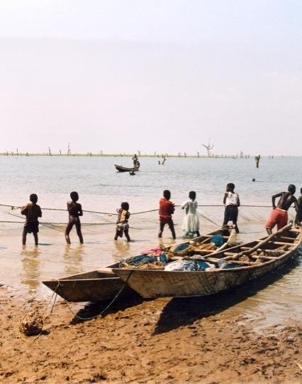
2. Definition of trafficking in persons
ACT
?
MEANS
Abuse of vulnerability
Deception
Withholding payments
PURPOSE
Labour exploitation
BASED ON THE PROVIDED INFO, IT IS NOT CLEAR WHETHER IT IS A FORM OF HUMAN TRAFFICKING OR LABOUR EXPLOITATION

Slide 23
2. Definition of trafficking in persons
ACT
(what is done)
MEANS
(how it is done)
PURPOSE
(why it is done)
Harbouring
Reception of a person
Recruitment
Transfer
Transport
Other
Abduction
Abuse of power
Abuse of vulnerability
Coercion
Deception
Fraud
Threat or use of force
Withholding of payments or benefits
Other
Exploitation, including:
Child labour exploitation
Coercive illegal activities
Coercive reproduction
Domestic servitude
Forced labour
Labour exploitation
Forced marriage
Forced military recruitment
Illegal adoption
Organ removal
Prostitution or sexual exploitation
Slavery
+
+
=
Trafficking in Persons (Adults)
CONSENT IS IRRELEVANT
because it is achieved through the use of means

Slide 24
2. Definition of trafficking in persons
ACT
(what is done)
+
MEANS
(how it is done)
+
PURPOSE
(why it is done)
=
* Trafficking in Persons (Children)
Means has no relevance from a legal point of view.
But it still has an importance from an information management perspective.
Flyers advertising scholarships and job opportunities abroad start appearing in the areas around secondary schools in a neighbourhood hosting a high number of IDPs.
MEANS
Deception
Risk of recruitment

Slide 25
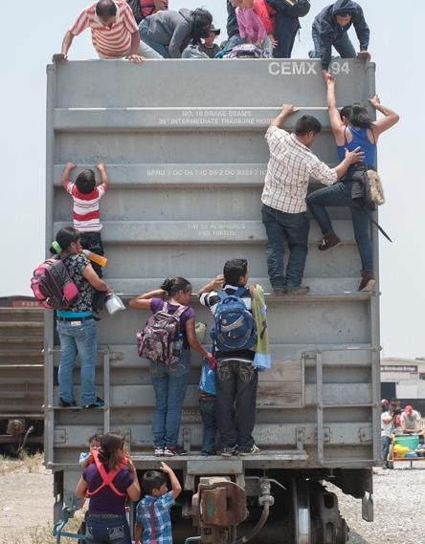
2. Definition of trafficking in persons
«Smuggling of migrants shall mean the procurement, in order to obtain, directly or indirectly, a financial or other material benefit, of the illegal entry of a person into a State Party of which the person is not a national or a permanent resident».
Protocol Against the Smuggling of Migrants by Land, Sea and Air, Supplementing the United Nations Convention Against Transnational Organized Crime (2000)

Slide 26
2. Definition of trafficking in persons
Trafficking in Persons
Smuggling of Migrants
Consent is irrelevant
Exploitation of Victim of Trafficking (VoT)*
No movement necessary
Consent is relevant **
Economic transaction between smuggler and person who is smuggled***
Cross-border movement ****
Notes:
Some sources prefer the use of the term “trafficking survivor” to that of “victim of trafficking”. While the intention to stress the resilience of the individual is well acknowledged, in this guide the use of VoT is preferred and motivated by two reasons. First, the stress is on the individual experience of being a victim of crime. Second, this guide suggests a variety of research approaches to understand trafficking patterns, trends, and risks, hence including undetected cases.

Slide 27
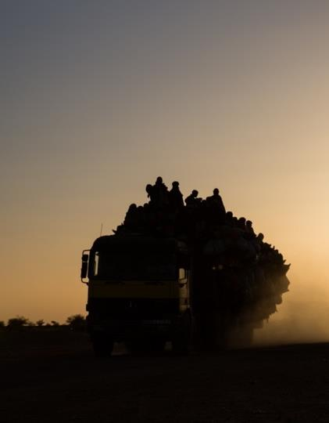
2. Definition of trafficking in persons
LEGAL DIFFERENCE ...
... BUT IS THE DIFFERENCE THAT CLEAR?
** Consent is relevant :
Dinamic of power between smuggled migrant and smuggler > the smuggler has more bargaining power
*** Economic transaction between smuggler and person who is smuggled:
What is a ‘fair’ price? What kind of material benefit? When does it become exploitation?
**** Only cross-border :
Concept applicable to intra-national movements if mobility is restricted.
FLUID DYNAMIC :
SMUGGLING CAN EASILY TURN INTO TRAFFICKING
DEFINITIONS ARE CLEAR BUT REALITIES ARE BLURRED
Notes:
In contexts of crisis, it is not unusual that movements within the national border might not be allowed – specific permissions or documents might be requested to move from one region to another and movements could be hindered or controlled for specific groups (i.e. IDPs, ethnic minorities, or refugees allowed to settle only in specific areas). While perhaps not captured in international conventions on smuggling, in these contexts, it is important to also consider intranational smuggling in relation to trafficking. Hindered freedom of movement, even within the national border, can be a driver for smuggling and create favorable conditions for trafficking.

Slide 28
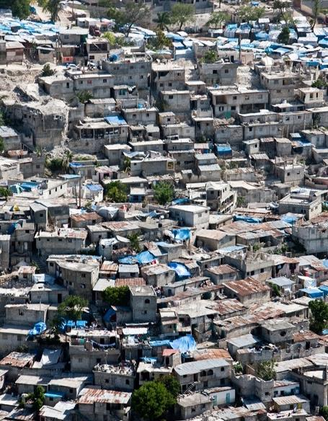
2. Definition of trafficking in persons
CONCRETE EXAMPLES:
ANY EXAMPLE OF TRAFFICKING TRENDS AND PATTERNS FROM THE COUNTRY/REGION WHERE YOU WORK?
ANY EXAMPLE OF BLURRED CASES OF SMUGGLING TRAFFICKING?
PLEASE WRITE YOUR ANSWER IN THE CHAT BOX
OR
RAISE YOUR HAND TO SPEAK

Slide 29
5 Minutes break
Notes:
Will make sure the DTM Reporting standards are referenced.

Slide 30
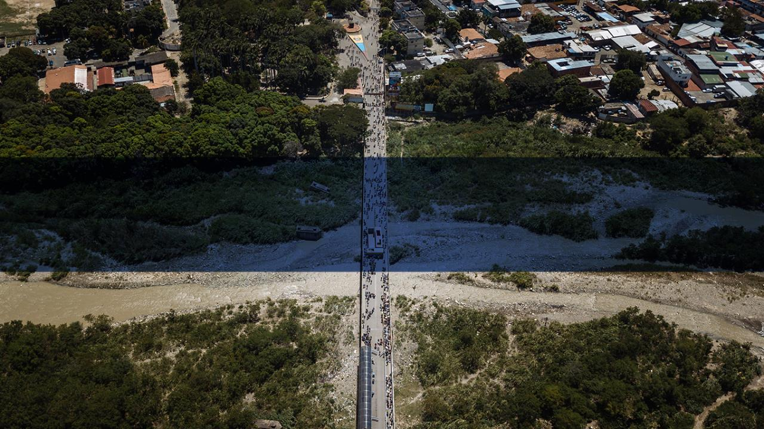
3. Existing data and research on trafficking in persons

Slide 31
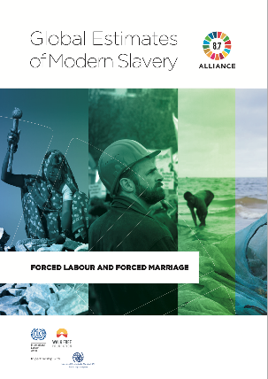
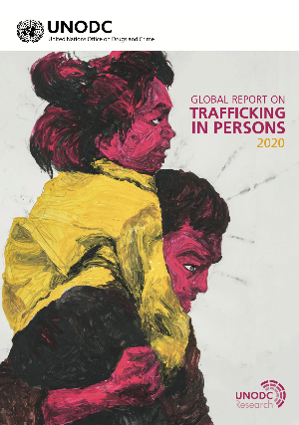
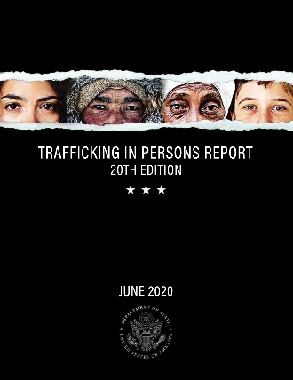
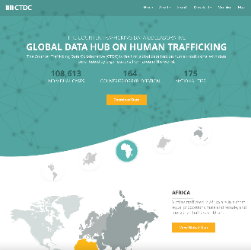
3. Existing data and research on TIP
DEVELOPMENT SECTOR (GREY LITERATURE)
ILO, IOM and Walk Free Foundation (2017):
Estimated 40 million victims of modern slavery of which approximately 24.9 million in forced labor.
UNODC (2020)
Global Report On Trafficking In Persons
JTIP (US) 2020
Trafficking in Persons Report
CTDC (IOM & Polaris)
(More than 100,000 cases)

Slide 32
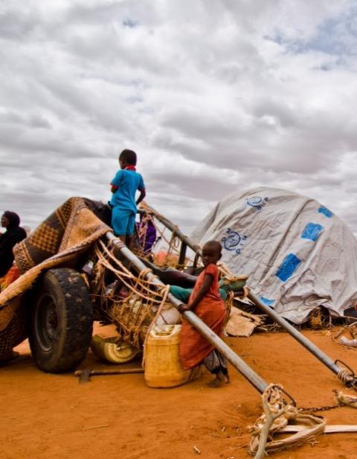
3. Existing data and research on TIP
KEY METHODOLOGICAL CHALLENGES and LIMITATIONS
TIP is a crime and hidden: prevalence is impossible to calculate and very hard to estimate.
Key sources are national statistics of detected cases: data tells more about the efficacy of law enforcement and bureaucracy than actual caseload.

Slide 33
3. Existing data and research on TIP
KEY METHODOLOGICAL CHALLENGES and LIMITATIONS
National legislations tend to criminalize or regulate (hence detect) some forms of exploitation more than others (i.e. prostitution is more regulated than labor exploitation)
Not all legal definitions are harmonized across countries: what is exploitation exactly? (i.e. kafala system)

Slide 34
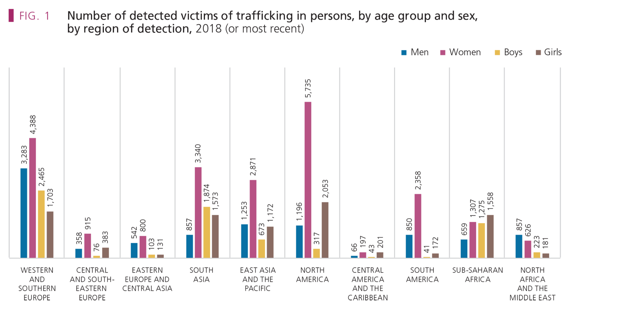

3. Existing data and research on TIP
UNODC, 2020

Slide 35
3. Existing data and research on TIP
UNODC, 2020

Slide 36
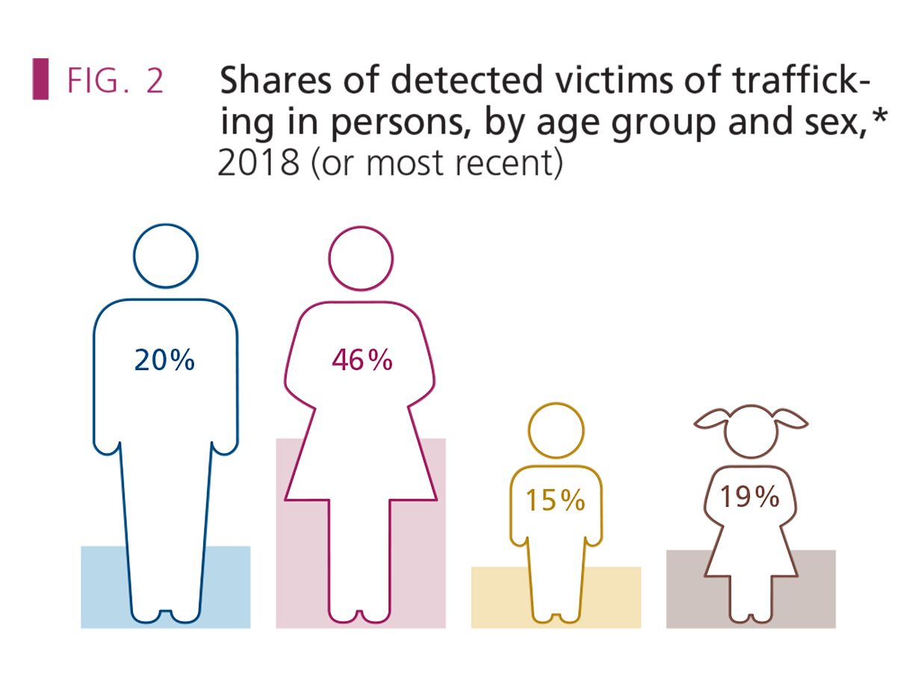
3. Existing data and research on TIP
Source:
UNODC elaboration of national data.
*Estimates are based on information referring to age and sex of 48,478 victims detected in 135 countries in 2018 or, if data not available for that year, in 2019, 2017 and 2016.
CASELOAD < 50,000 ppl

Slide 37
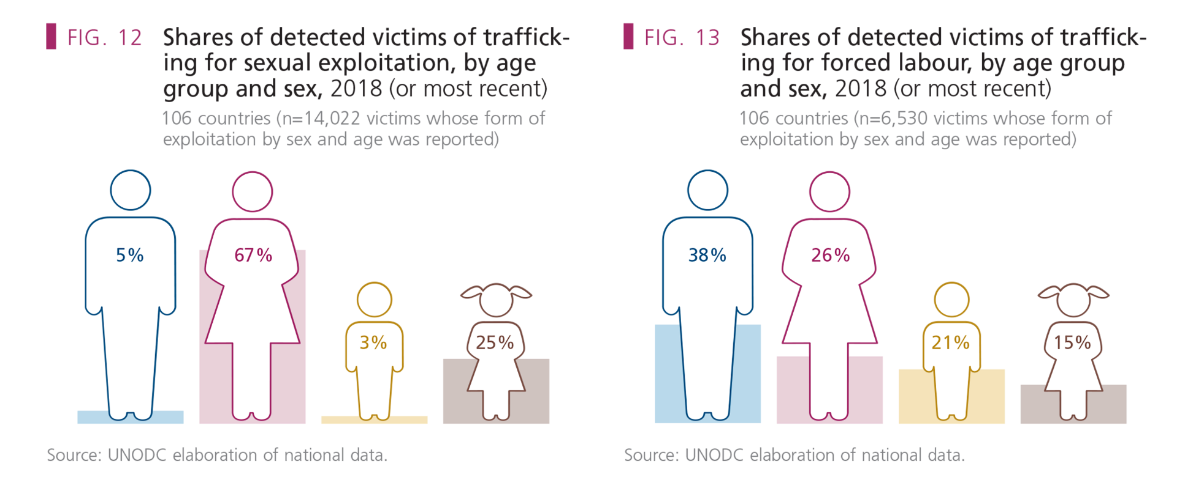
3. Existing data and research on TIP

Slide 38
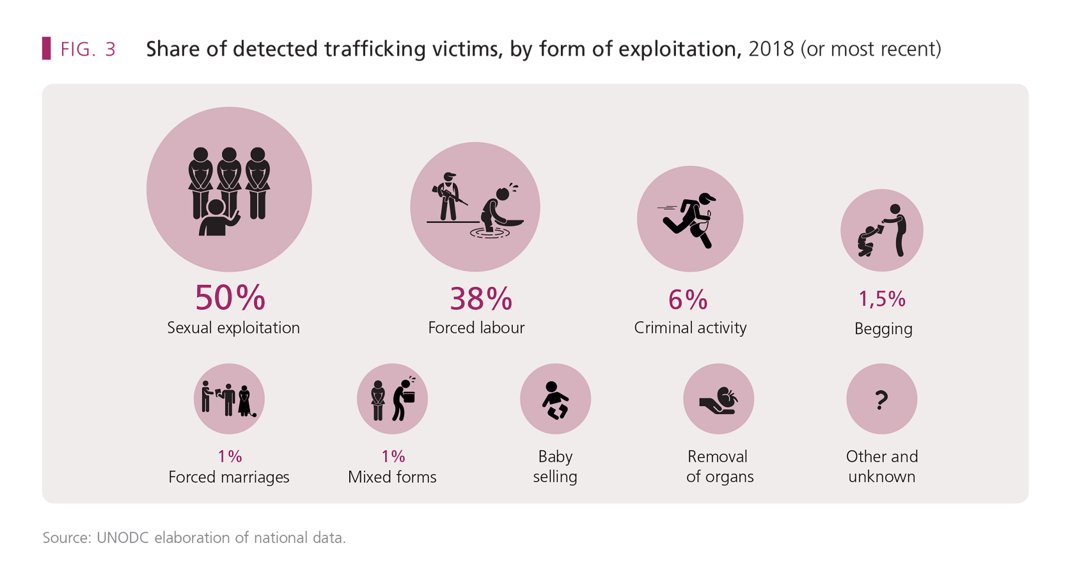
3. Existing data and research on TIP
UNODC, 2020

Slide 39
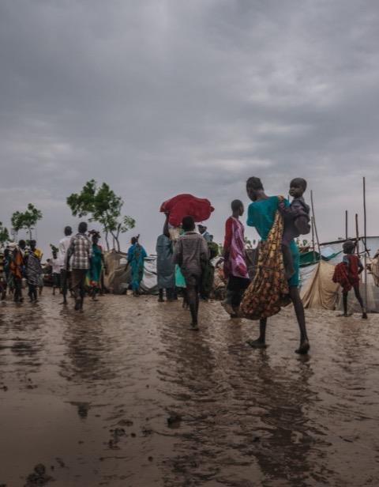
3. Existing data and research on TIP
Systematic reviews of academic literature from 2000 to 2020:
Alarming lack of empirical studies (hard to conduct);
Predominance of qualitative small scope research over quantitative;
The few quantitative studies are not generalizable (non-probabilistic sampling);
Almost exclusive focus on sexual exploitation and/or women VoTs.
Geographical narrow focus on Europe and North America.

Slide 40
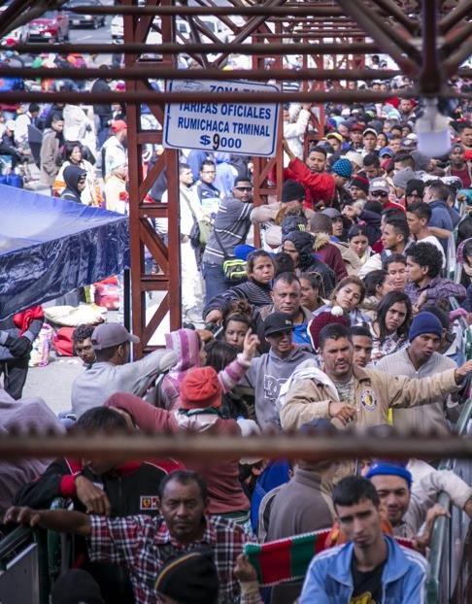
3. Existing data and research on TIP
Information gaps
The tip of the iceberg : excessive focus on the “visible” rather than the “invisible’’
Lack of evidence from low- and mid-income countries / countries affected by humanitarian crises
Victim-centred research approach:
Ethical dilemmas and safety & security risks
Survival bias
Disproportionate focus on women and girls as victims of sexual exploitation
Narrow focus on individual-level factors (rather than meso and macro factors)

Slide 41
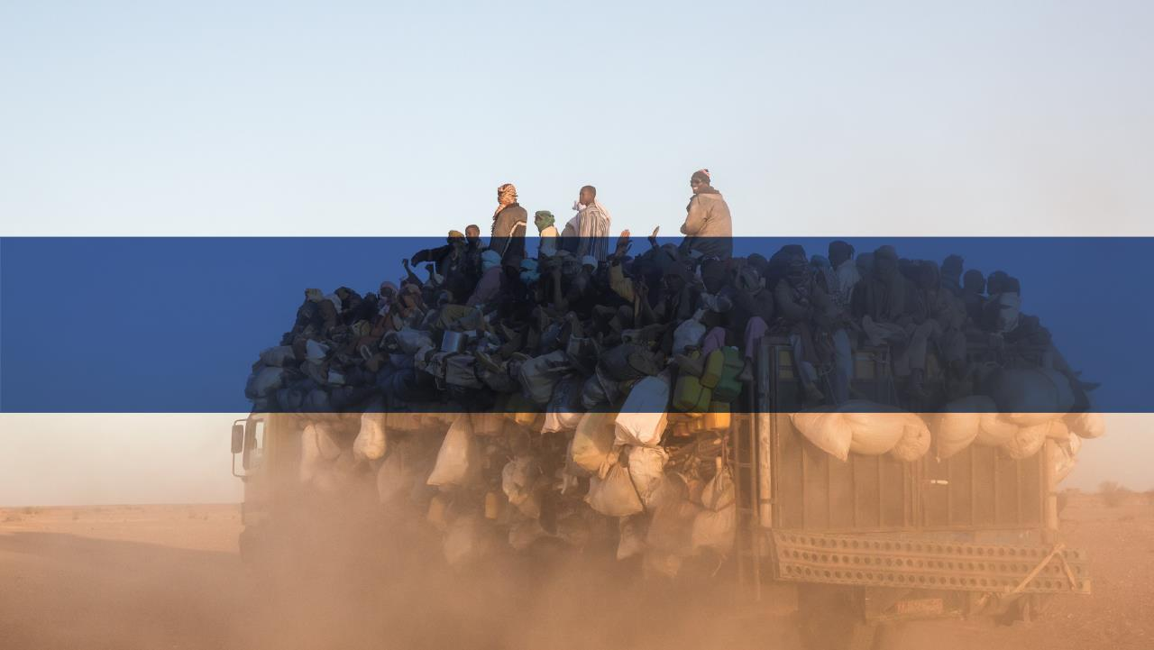
4. Trafficking in persons in emergencies

Slide 42
4. Trafficking in persons in emergencies
Economic and political instability associated to conflict or natural disasters
Deterioration of living conditions and resort to negative coping strategies
Collapse of rule of law and spreading impunity
Internal displacement and cross-border movements
State failure
Erosion of protection systems
HUMANITARIAN CRISES EXACERBATE PRE-EXISTING TRAFFICKING TRENDS AND CREATE A FERTILE SOIL FOR NEW ONES.

Slide 43
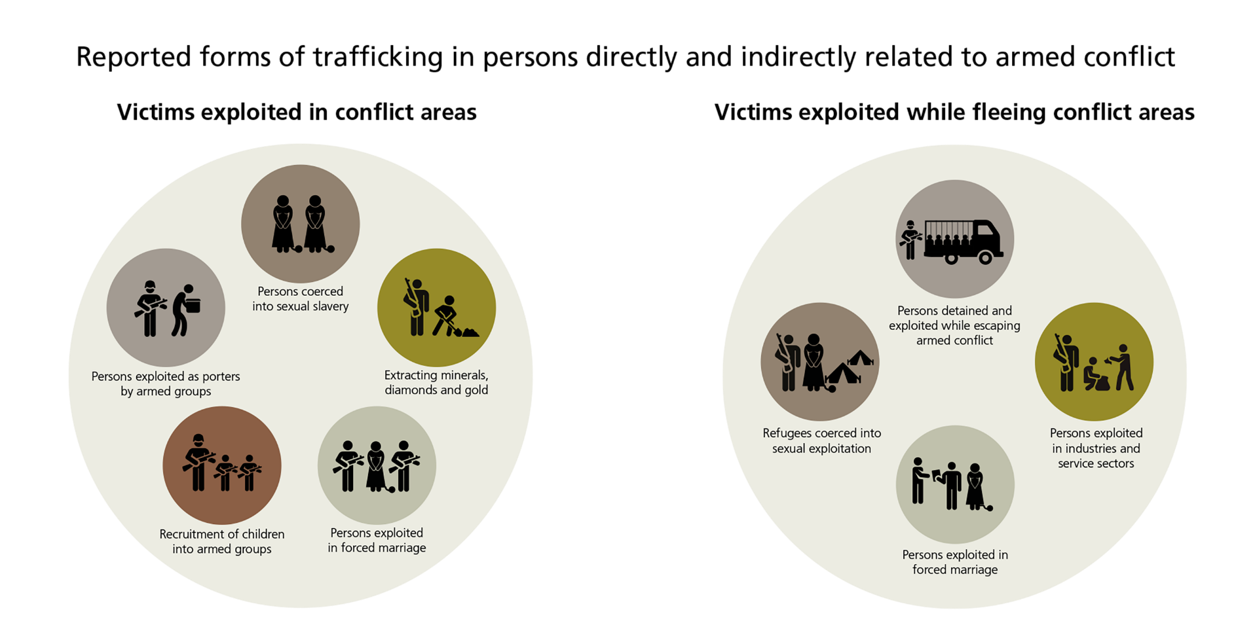
4. Trafficking in persons in emergencies
UNODC, 2020

Slide 44
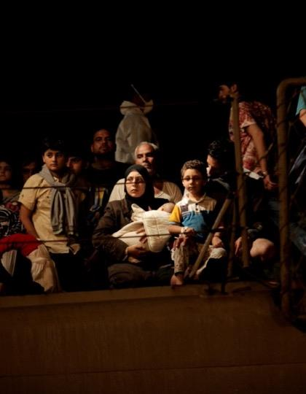
4. Trafficking in persons in emergencies
COUNTER-TRAFFICKING:
Not homogeneous nor widespread implementation
Not mainstreamed
Mentioned in very few HNOs/HRPs (usually brief narrative, no data nor evidence other than anecdotal)
Often absorbed into CP and GBV
Rarely specific task forces or working groups are in place

Slide 45
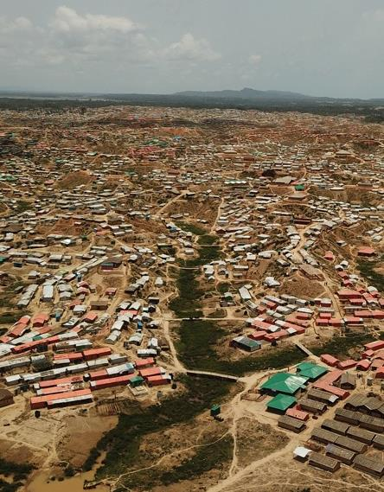
4. Trafficking in persons in emergencies
CONCRETE EXAMPLES:
Is counter-trafficking integrated in the responses where you work?
Any example from your work experience?
PLEASE WRITE YOUR ANSWER IN THE CHAT BOX
OR
RAISE YOUR HAND TO SPEAK

Slide 46
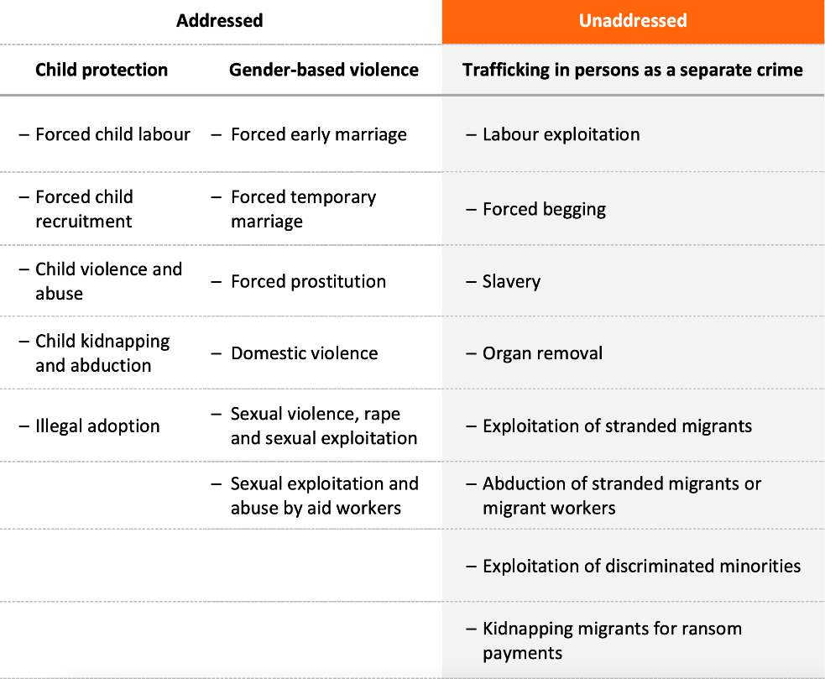
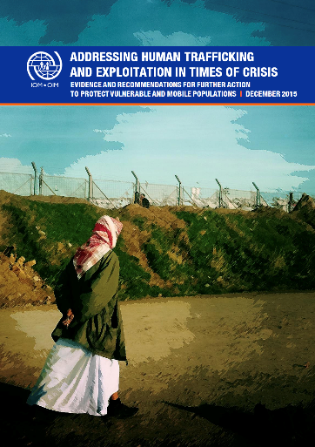
4. Trafficking in persons in emergencies
Addressing human trafficking and exploitation in times of crisis
(IOM, 2015)

Slide 47
4. Trafficking in persons in emergencies
Addressing human trafficking and exploitation in times of crisis
(IOM, 2015)

Slide 48
4. Trafficking in persons in emergencies
TIP in EMERGENCIES
Trafficking in Persons
Migration
Assistance gap: certain categories of vulnerable people remain unassisted because they fall in the cracks;
Lack of prevention programming;
Trafficking, smuggling, displacement and migration are intertwined. TIP is not a niche problem;
Smuggling
Internal
displacent

Slide 49
4. Trafficking in persons in emergencies
TIP in EMERGENCIES
Trafficking in Persons
Migration
Being recognized as VoT often grants forms of international protection;
Being recognized as VoT permits the application of the non-punishment principle, according to which VoTs cannot be prosecuted for their involvement in unlawful activities committed because of being trafficked.
Smuggling
Internal
displacent

Slide 50
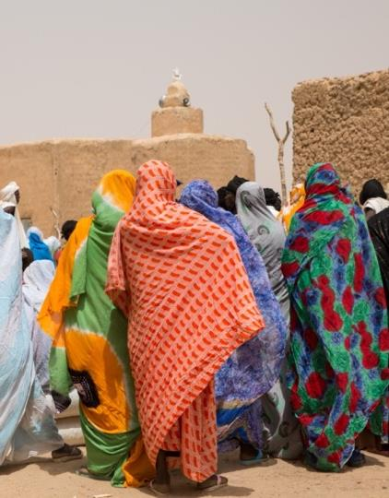
4. Trafficking in persons in emergencies
International law recognizes that all persons have human rights, which must be respected and protected. This normative framework extends to all people on the move, irrespective of their migration status. International law also provides international protection frameworks for well-established categories of people such as refugees and trafficked persons.
2030 Agenda for Sustainable Development. Committed to facilitating orderly, safe and responsible migration and mobility while also eradicating forced labour, modern slavery and human trafficking (SDG 5.3, SDG 8.7, SDG 16.2).
The Global Compact for Safe, Orderly and Regular Migration Non-binding agreement to address and reduce vulnerabilities in migration and to enhance international cooperation for the improvement of migration governance holistically and comprehensively.
GPC Anti-Trafficking Task Team (est. 2017) An Introductory Guide to Anti-Trafficking Action in Internal Displacement Contexts: 2020
Notes:
5 Gender equality
5.2 Eliminate all forms of violence against all women and girls in the public and private spheres, including trafficking and sexual and other types of exploitation
8. Decent work and economic growth
8.7 Take immediate and effective measures to eradicate forced labour, end modern slavery and human trafficking and secure the prohibition and elimination of the worst forms of child labour, including recruitment and use of child soldiers, and by 2025 end child labour in all its forms
Goal 16: Promote just, peaceful and inclusive societies
16.2 End abuse, exploitation, trafficking and all forms of violence against and torture of children

Slide 51
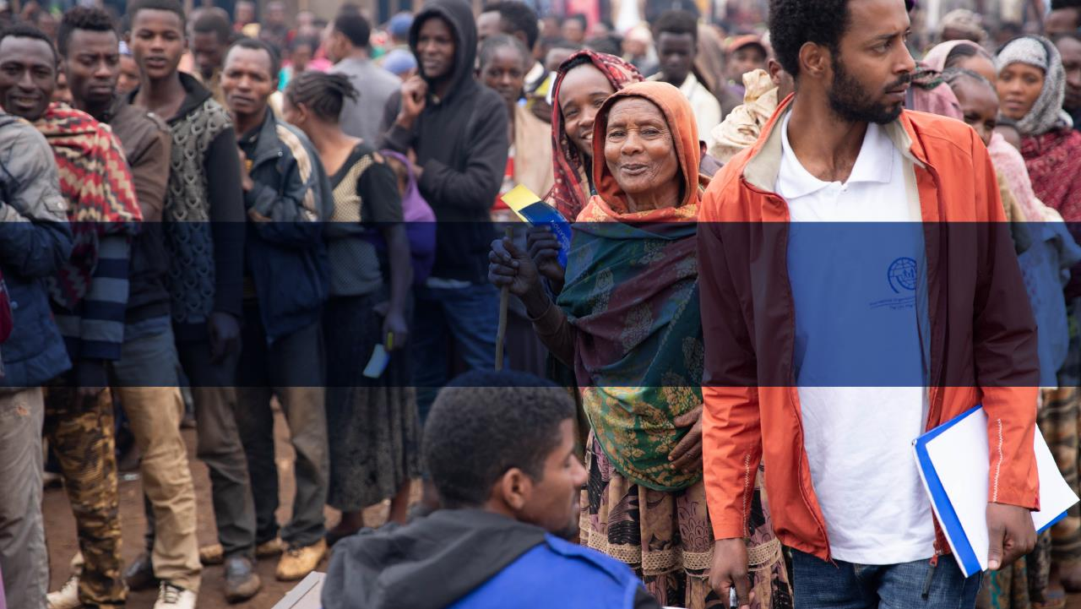
5. Function and purpose of CT information management in emergencies

Slide 52
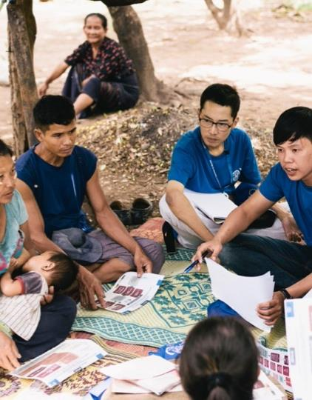
5. Function and purpose of CT im in emergencies
CTiE IM SCOPE
CTiE IM Guide designed for emergency and “emergency-like” contexts;
Fit for a response architecture more than just for a specific context.

Slide 53
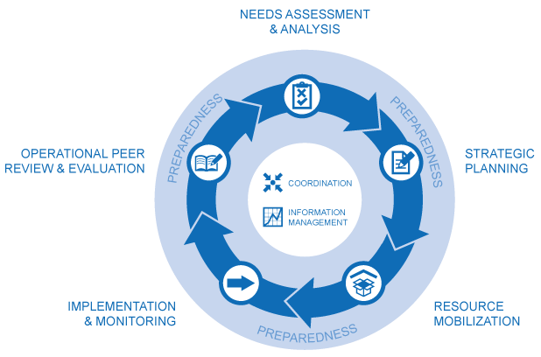
5. Function and purpose of CT IM in emergencies
IM plays a key role in a Humanitarian Program Cycle (HPC)
Humanitarian Needs Overview - HNO
Coordination
Monitoring & Evaluation
OCHA: https://www.humanitarianresponse.info/en/programme-cycle/space

Slide 54
5. Function and purpose of CT IM in emergencies
IM plays a key role in a Humanitarian Program Cycle (HPC)
Humanitarian Needs Overview - HNO
Coordination
Monitoring & Evaluation
The HNO is the base of the Humanitarian Response Plan (or RRP or JRP)
The humanitarian response architecture and leadership might change. Still a needs analysis and strategic planning process based on the HRP/RRP blueprint normally takes place at least once a year, at the local, country or regional level.
OCHA: https://www.humanitarianresponse.info/en/programme-cycle/space
Notes:
This is a collaborative process in which all clusters and actors participate. The typical documents produced by such a process are the yearly humanitarian needs overview (HNO) and the yearly humanitarian response plan (HRP). Depending on the context and the humanitarian coordination structure in place, this can be OCHA-led, which produces the HNO and HRP; UNHCR-led in case of refugee responses, which would produce a refugee response plan (RRP); or co-led by more than one actor or by an inter-cluster coordination group (ICCG). Irrespective of the various delineations that the humanitarian response coordination architecture may have, a needs analysis and strategic planning process based on the HRP/RRP blueprint normally takes place at least once a year, at the local, country or regional level.
The HNO and HRP are typically produced once a year, but the schedule might vary. Additionally, depending on the context, similar collective exercises might take place to support flash appeals following sudden-onset crises.

Slide 55
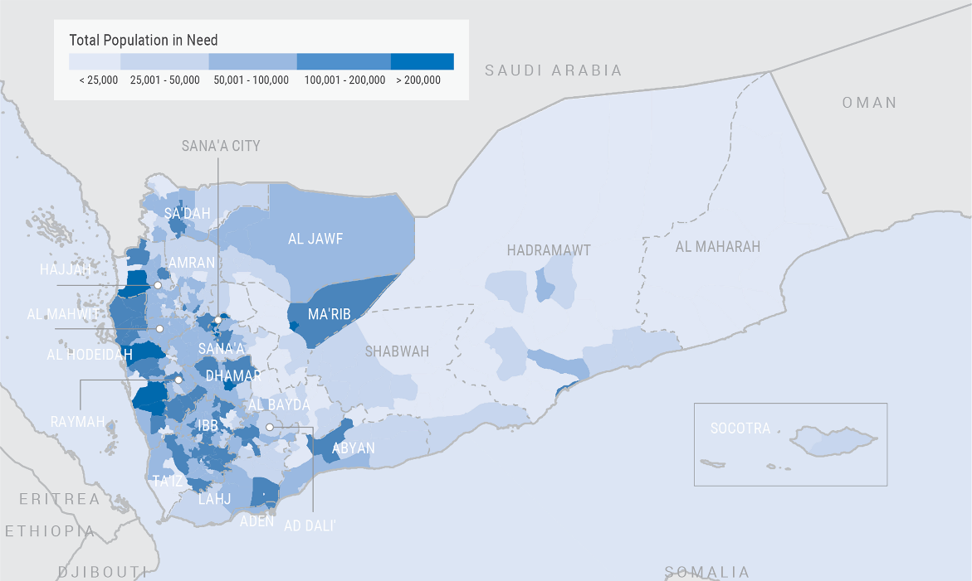
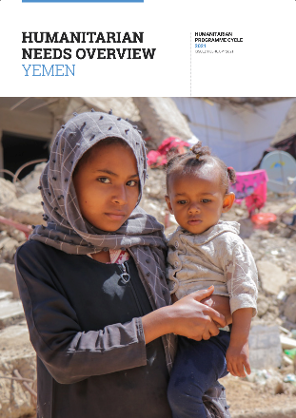
5. Function and purpose of CT IM in emergencies
YEMEN Humanitarian Needs Overview (HNO)
Feb 2021
OCHA-led response on a country level:
HNO > HRP

Slide 56
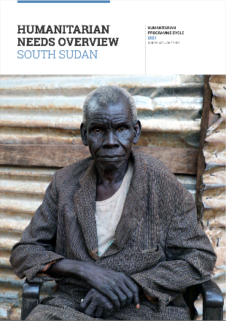
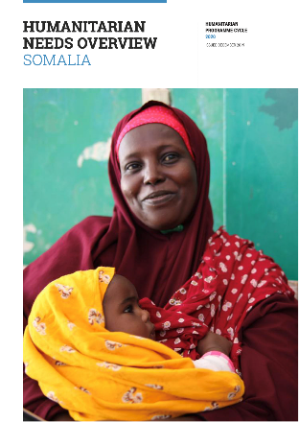
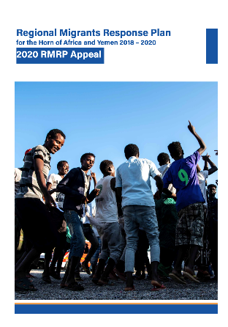
5. Function and purpose of CT IM in emergencies
SOUTH SUDAN Humanitarian Needs Overview (HNO)
Feb 2021
SOMALIA Humanitarian Needs Overview (HNO)
Feb 2021
IOM Regional Migration Response Plan (RMRP) for EHoA And Yemen
2020
Etc.
Individual HNOs > HRPs per country
Regional IOM Migration response

Slide 57
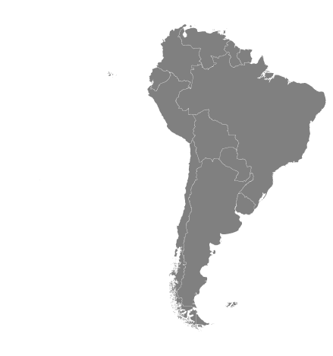
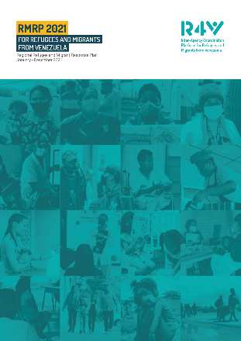
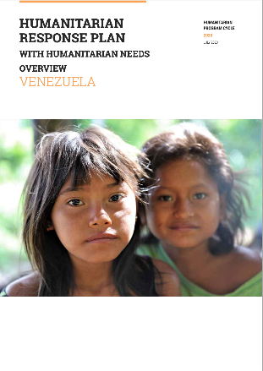
5. Function and purpose of CT IM in emergencies
Regional Refugee and Migrant Response Plan for Refugees and Migrants from Venezuela (RMRP)
January 2021
VENEZUELA Humanitarian Needs Overview (HNO)
January 2020
Regional response for Venezuela migrants and refugees co-led by IOM & UNHCR
Venezuela only country with an HNO (related to the same crisis) and not officially OCHA-led

Slide 58
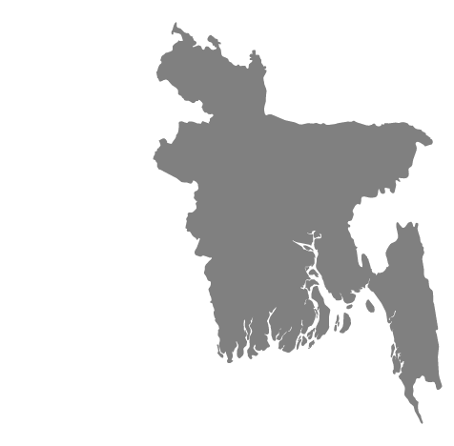
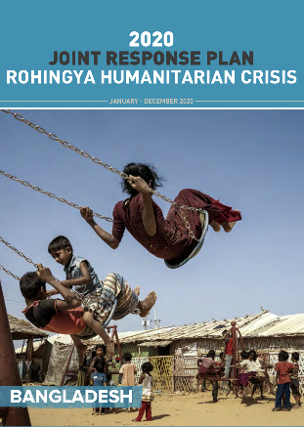
5. Function and purpose of CT IM in emergencies
Rohingya responce localised in one region only. Co-led by IOM & UNHCR under the Inter-Sector Coordinating Group secretariat (ISCG). Produces Joint Needs Overview (JNO) and Joint Response Plan (JRP)
Response for large scale events (i.e. cyclone) at county level led at Dhaka level through different architecture
JOINT RESPONSE PLAN for the ROHINGYA HUMANITARIAN CRISIS
(2020)

Slide 59




5. Function and purpose of CT IM in emergencies
Information collected at different stages can inform responses in other countries

Slide 60
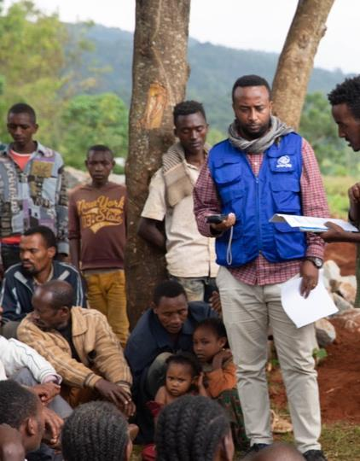
5. Function and purpose of CTiE IM
CTiE IM SHOULD
Investigate and provide information on the general context, pre-existing and new trafficking patterns and trends, trafficking drivers, and modalities through which the present crisis has had an effect on them;
Identify risks related to trafficking and factors that might increase or mitigate these risks and the exposure of people to them, also taking note of vulnerable groups and factors increasing or mitigating such vulnerability (to trafficking).

Slide 61
5. Function and purpose of CTiE IM
CTiE IM SHOULD NEVER
Attempt to PRODUCE PREVALENCE (the total number of cases of TIP in a population at a given time) is resource-intensive, challenging and complex, even in stable contexts. For the purpose of CTiE, it is a completely UNNECESSARY RISK.
Attempt to screen and/or identify VoTs.

Slide 62
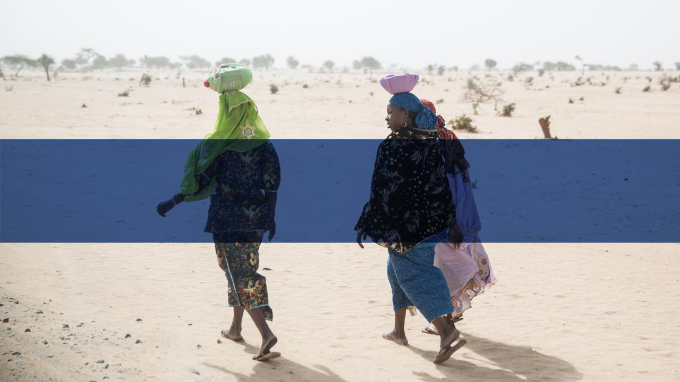
6. Questions

Slide 63
Further readings and recommended sources
IOM Counter-Trafficking in Emergencies: Information Management Guide (2020)
Chapter 1 (Introduction)
Chapter 2 (Counter-trafficking in emergencies)
Chapter 4 (CTiE information management: purpose and function): Paragraphs 4.1 / 4.2 / 4.3. Technical aspects of 4.2 and 4.3 will also be treated in the coming sessions.

Slide 64
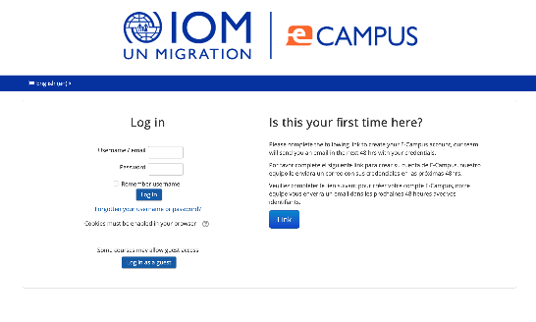

Further readings and recommended sources
Trainings
IOM eCampus
Counter Trafficking in Humanitarian Settings.
UNODC eLearning
Human Trafficking.

Slide 65
Further readings and recommended sources
TIP key references
IICAT, 2012: International legal framework. In: Toolkit to Combat Trafficking in Persons.
ICAT, 2012: The international legal frameworks concerning trafficking in persons.
ICAT, 2016: What is the difference between trafficking in persons and smuggling of migrants?
ICAT, 2020: Non-punishment of victims of trafficking.
ILO, 2014: Brief on the Protocol to the Forced Labour Convention.
ILO Forced Labour Convention 1930 (No. 29) and Abolition of Forced Labour Convention 1957 (No. 105).
ILO, IOM and Walk Free Foundation, 2017: Global estimates of modern slavery: Forced labour and forced marriage.
OHCHR, 2000: UN Protocol to Prevent, Suppress and Punish Trafficking in Persons Especially Women and Children, supplementing the United Nations Convention against Transnational Organized Crime.
OHCHR, 2014: Human rights and human trafficking.
UNODC, 2015: The concept of “exploitation” in the Trafficking in Persons Protocol.
UNODC, 2018: The International Legal Definition of Trafficking in Persons: Consolidation of research findings and reflection on issues raised.
UNODC, 2020: Global Report on Trafficking in Persons

Slide 66
Further readings and recommended sources
TIP in emergencies (conflict and natural disasters)
GPC ATTT, 2020 (2020): Guidance on anti-trafficking action in internal displacement contexts.
ICAT, 2017: Trafficking in persons and refugee status. Issue brief No. 3.
IOM, 2015: Addressing human trafficking and exploitation in times of crisis: Evidence and recommendations for further action to protect vulnerable and mobile populations.
The Freedom Fund, 2016: Modern slavery and trafficking in conflict: The UN’s response.
UNHCR, 2006: Guidelines on international protection: The application of Article 1A(2) of the 1951 Convention and/or 1967 Protocol relating to the Status of Refugees to victims of trafficking and persons at risk of being trafficked.
UNODC, 2018: Countering trafficking in persons in conflict situations. Thematic paper.
UNODC, 2018: Global Report on Trafficking in Persons – in the context of armed conflict 2018.

Slide 67
For Support, contact:
IOM Migrant Protection and Assistance Division (MPA):
Counter Trafficking in Emergency Team: CTiEHQ@iom.int

